Slide 1
WBL Forms: Proposed changes
Only Design Changes:
District Response Form
Combining forms:
Memorandum of Agreement + Co-op Agreement
Parent Agreement + Permission to Leave
Emergency Medical
Training plan/Employer Assessment:
  Should use PEPS not entirely different set of items/skills!
Further Work Needed/More Flexible:
Training Plan
Training Plan Narrative
New forms:
Appearance Enhancement
Extended Classroom

Slide 2
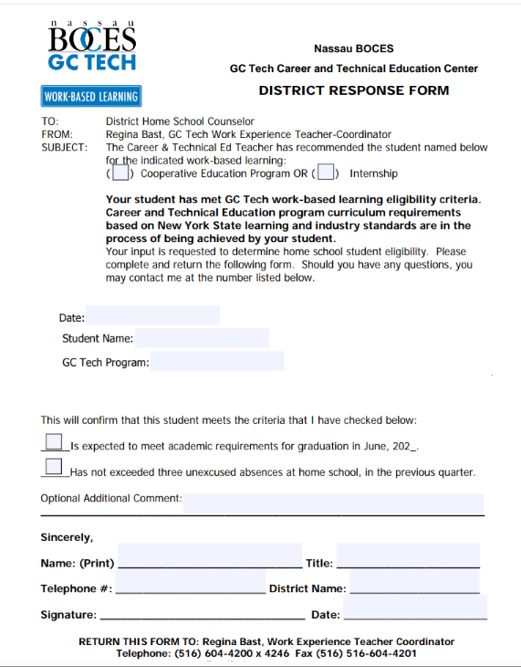
Only design changes: District Response Form
The district response form gives districts an opportunity to state if the student is eligible for WBL based on academics and attendance at home school.

Slide 3
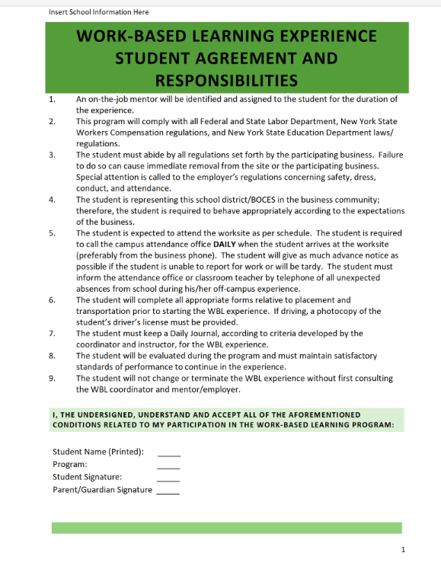
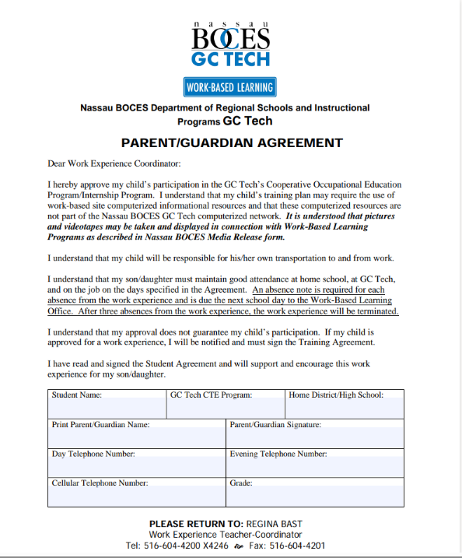
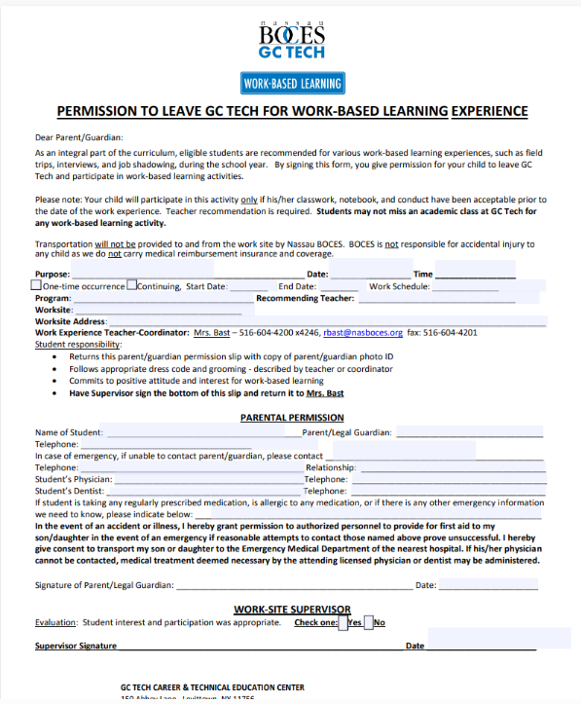
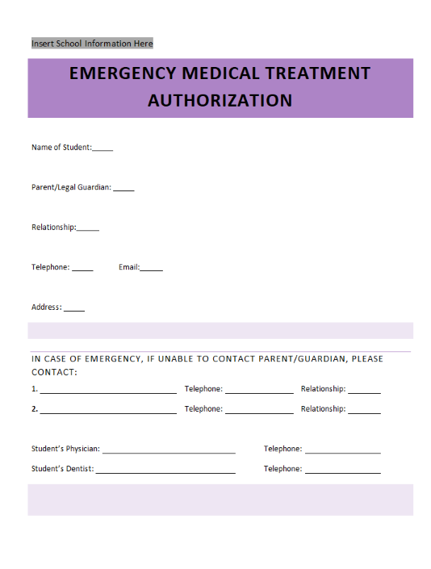
Parent/Student Agreements
Emergency Authorization
Notes:
The current documents used are a “Parent/Guardian Agreement” and a “Permission to Leave GC Tech for Work Based Learning” document that includes an emergency treatment authorization. There are a lot of redundencies in what the documents are saying.
The emergency information document currently does not go to the employer, which causes challenges in case of emergency.
The state sample puts all of the agreements needed by parents and students into one document that is signed by both parents and students.
We should update item #5 for each school’s preferred method of taking attendance.

Slide 4
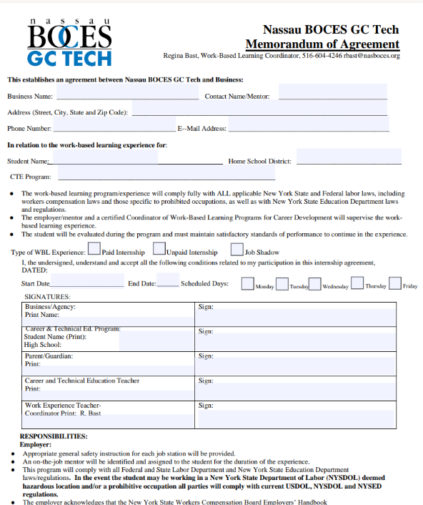
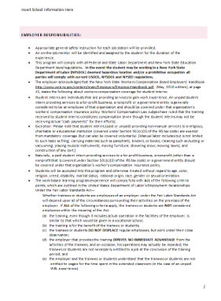
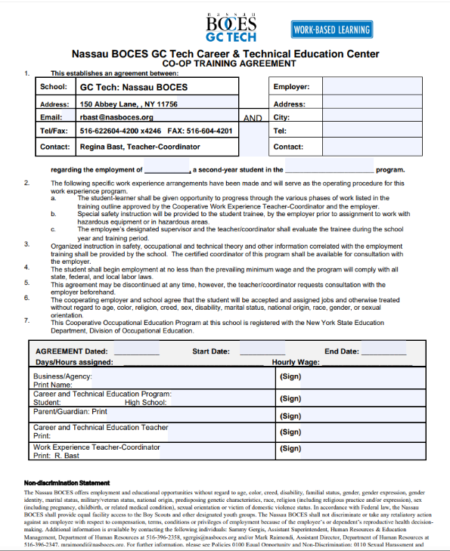
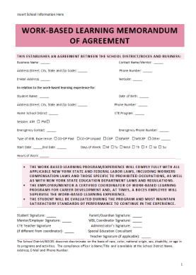
Memorandum Of Agreement

Slide 5
Memorandum Of Agreement
Currently we use a Memorandum of Agreement
AND a “Co-op Training Agreement” which
duplicates information, but does not include all relevant info on both pages.
The state sample is a singular document
Which includes all relevant information.

Slide 6
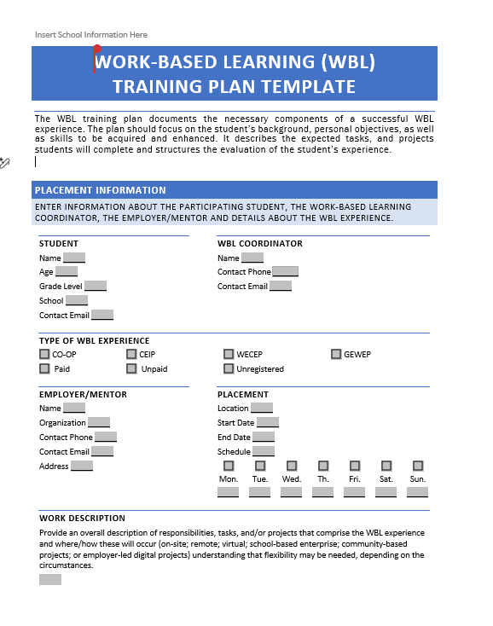
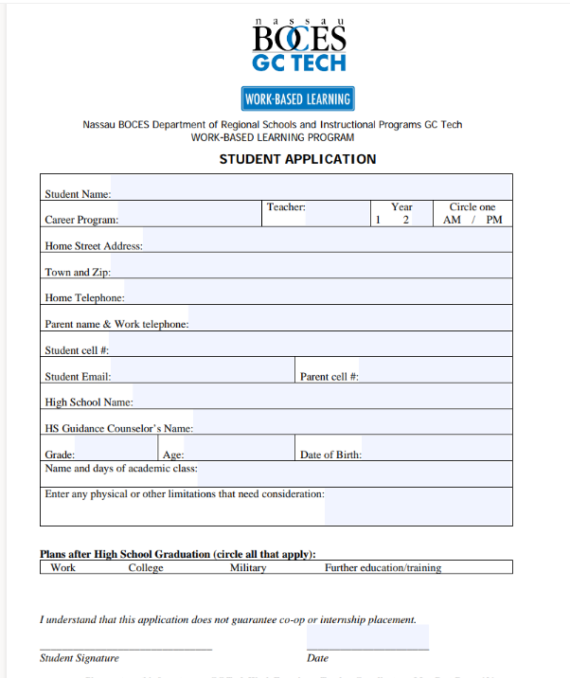
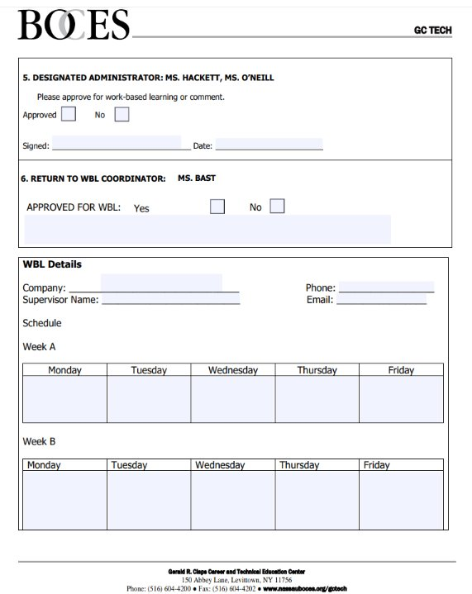
Training Template &
Narrative
Notes:
Previous “Student Application” and internal work schedule tracking sheet can be replaced by the WBL Training Plan Template which incorporates the demographics, and employer information. The benefit is streamlined communication and reduced duplication. Previously some information was only captured on internal documents, and captured multiple times.

Slide 7
Training Template &
Narrative
Previous “Student Application” and internal work schedule tracking sheet can be replaced by the WBL Training Plan Template which incorporates the demographics, and employer information.
Notes:
Previous “Student Application” and internal work schedule tracking sheet can be replaced by the WBL Training Plan Template which incorporates the demographics, and employer information. The benefit is streamlined communication and reduced duplication. Previously some information was only captured on internal documents, and captured multiple times.

Slide 8
Forms the State Recommends
We do not currently use an Employment Enhancement or External Classroom form, but there are samples provided on the NYSED website. Examples are on the following slides

Slide 9

Extended Classroom
New form covers situations when the “WBL” is an activity happening as an extracurricular or extended class time experience supervised by a teacher.

Slide 10
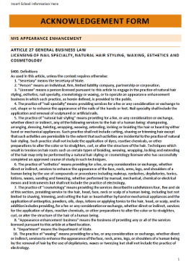
Appearance Enhancement
NYSED has a sample form for placing students in appearance enhancement and protects us by emphasizing the legal limits for student participation in a salon.

Slide 11
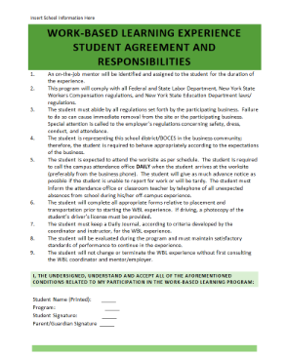
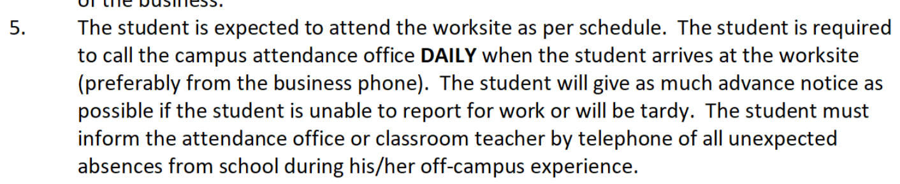
Discussion points
Green document
  What to put on item 5 for method to call out?
  Current language

